Slide 1
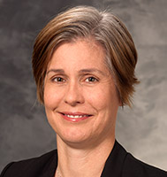
2020-21
Annual Women in Surgery Visiting Lectureship
Sponsored by the Loyola Women in Surgery Group
Department of Surgery - Grand Rounds
Wednesday, January 27, 2021 ● 7am - 8am
Zoom ID: 522 550 696
Caprice Christian Greenberg, MD, MPH Professor of Surgery with Tenure
Morgridge Distinguished Chair in Health Services Research
University of Wisconsin - Madison
From Evidence to Implementation: The Current State of Surgical Coaching

Slide 2
Loyola Women in Surgery Group
Established in 2010
Missions
To provide a forum for networking opportunities to enhance career satisfaction
To encourage professional development and academic growth
To provide opportunities to mentor and be mentored
To promote an environment that fosters inclusion, respect and success
Notes:
The Loyola WIS group was established 11 years ago, in 2010
The missions of the group are…
Over the past 10 years, the Loyola WIS group has worked to accomplish these missions by sponsoring a number of group events, funding travel for academic development for faculty and trainees annually as well as student opportunities. This is made possible by a generous unrestricted medical education grant from Gore.

Slide 3
Loyola Women in Surgery Group
Established Annual Women in Surgery sponsored lectureship in 2018
2018-19 Rebecca Sippel, MD (U Wisconsin)
2019-20 Jamie Coleman, MD (U Colorado)
2020-21 Caprice Greenberg, MD, MPH (U Wisconsin)
2021-22 Julie Freischlag, MD (Wake Forest)
Notes:
In addition to that, the group established a commitment to sponsoring an annual visiting lectureship, allowing the Department to bring in such distinguished and accomplished surgeons as Dr. Greenberg to participate in Department of Surgery grand rounds. This is a list of WIS sponsored speakers, including Dr. Greenberg’s colleague, Dr. Sippel.

Slide 4
Caprice Christian Greenberg, MD, MPH
Undergraduate
University of Chicago
Medical School
University of Chicago Pritzker School of Medicine
General Surgery Residency
Brigham and Women’s Hospital
Masters of Public Health
Harvard School of Public Health
Surgical Oncology Fellowship
Partners-Dana Farber Cancer Center
Notes:
Native of Chicago
BA Chemistry
AOA

Slide 5
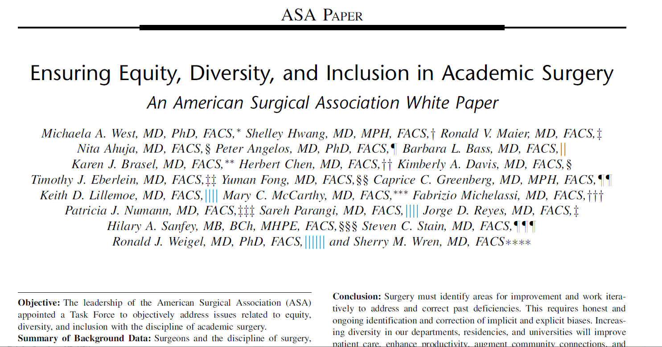
Caprice Christian Greenberg, MD, MPH
Tenured Professor of Surgery
Morgridge Distinguished Chair in Health Services Research
University of Wisconsin
Incoming Chair, Department of Surgery
Medical College of Georgia at Augusta
Notes:
Dr. Greenberg is a surgical oncologist specializing in breast cancer and a health services researcher focused on improving patient safety and quality of care.
She is involved in multiple academic surgical societies and served as the President of the Association for Academic Surgery in 2017, delivering an insightful presidential address entitled ‘Sticky floors and glass ceilings’, which addressed the challenges encountered in the advancement of women in academic surgery and the status of gender disparities.
(CLICK) She co-authored the ASA white paper entitled Ensuring Equity, Diversity and Inclusion in academic surgery and she is actually scheduled to join our citywide Vascular Surgery journal club tonight to discuss it.
Dr. Greenberg is an extensively funded researcher with several active R01 grants, one focused on the study of surgical coaching, which she’ll be talking about this morning.
She was recently named chair of the Dept of Surgery at the Medical College of GA, a role that she will move on to in May of this year.

Slide 6
2021-22
Annual Women in Surgery Visiting Lectureship
Sponsored by the Loyola Women in Surgery Group
Department of Surgery - Grand Rounds
Wednesday, January 27, 2021 ● 7am - 8am
Zoom ID: 522 550 696
Caprice Christian Greenberg, MD, MPH Professor of Surgery with Tenure
Morgridge Distinguished Chair in Health Services Research
University of Wisconsin - Madison
From Evidence to Implementation: The Current State of Surgical Coaching

